Slide 1




Indirect Rebound Involving Embodied Energy Use in Re-spending Decisions
How Do We Treat Negative Multiplier Effects in Energy Supply Chains?
Karen Turner and Antonios Katris
Centre for Energy Policy
University of Strathclyde
IAEE Conference, Bergen 21 June 2016
Project Title: ‘Energy Saving Innovations and Economy-Wide Rebound Effects’
Project web-site: http://www.cied.ac.uk/research/impacts/energysavinginnovations
EPSRC Grant Ref. EP/M00760X/1

Slide 2
What is rebound effect?
Increased energy efficiency leads to monetary savings of households
  Incentive to consume more energy (direct rebound)
  More consumption of non-energy goods (indirect rebound)
  Full economic adjustment (economy-wide rebound)
Rebound effect is the difference between the anticipated and the actual energy savings

Slide 3
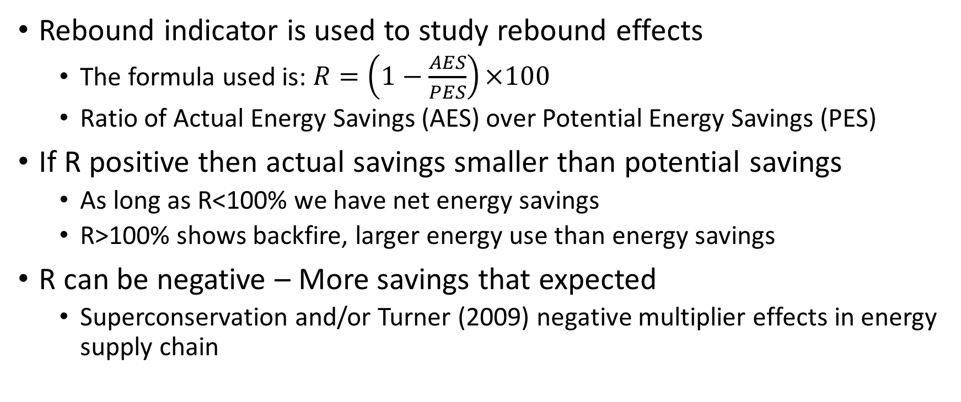
How do we study rebound effects?
Rebound indicator is used to study rebound effects
  The formula used is: $R=\left(1−\frac{AES}{PES}\right)×100$
  Ratio of Actual Energy Savings (AES) over Potential Energy Savings (PES)
If R positive then actual savings smaller than potential savings
  As long as R<100% we have net energy savings
  R>100% shows backfire, larger energy use than energy savings
R can be negative – More savings that expected
  Superconservation and/or Turner (2009) negative multiplier effects in energy supply chain

Slide 4
Is rebound indicator effective?
R indicates our failure to correctly estimate/realise the savings from improved energy efficiency
There is no standard definition of what is included in PES
Guerra and Sancho (2010) and Turner (2013) present completely different approaches

Slide 5
What is our goal?
We want to highlight the different results under different interpretations of PES
  Turner (2013) – PES = engineering savings
  Guerra and Sancho (2010) – PES = engineering savings + quantity adjustment
  They both agree on using IO to calculate quantity adjustment
Can we get the same information using a different indicator?
Transparency on the economy-wide impacts of improved energy efficiency is key
  Methodology disaggregates supply chains in IRIO
  Use of WIOD data for 2009

Slide 6
An illustrative example
We assume a 10% reduction in UK household ‘Electricity, Gas and Water Supply’ spending ($5,525m) due to improved energy efficiency
 |  | Energy use (terajoules) | Related CO2 (kilotonnes)
 | A. Reduction in direct energy use by UK households | -152,591 | -6,172
 | Reductions in energy use in UK EGWS supply chains:
 | Total multiplier effect per $1m spend: | 38.14 | 1.89
 | B. Direct - own-sector (25.9tj/1.26kt per $1m) | -143,142 | -7,777
 | C. Indirect - own-sector (8.33tj/0.41kt per $1m) | -46,040 | -2,501
 | D. Indirect - other UK (1.06tj/0.08kt per $1m) | -5,878 | -471
 | Sub total UK | -195,060 | -10,749
 | E. Indirect - outside of UK (2.84tj/0.15kt per $1m) | -15,713 | -926
 | Global total | -210,773 | -11,675
 | Total reduction in UK energy use | -347,651 | -16,921
 | Total reduction in global energy use | -363,364 | -17,847
 | Ratio of Total global reduction over direct reduction | 2.38 | 2.89

Slide 7
Rebound effects in our example
 | Energy use | CO2
Actual energy savings (AES):
UK level | 347,651 | 16,921
Global level | 363,364 | 17,847
Potential energy savings and rebound:
Guerra and Sancho (2010) - all included in PES
UK level:
PES (A, B, C, D) | 347,651 | 16,921
Rebound | 0% | 0%
Global level
PES (A, B, C, D, E) | 363,364 | 17,847
Rebound | 0% | 0%
Turner (2013) - only household direct saving included in PES
UK level:
PES (A) | 152,591 | 6,172
Rebound | -128% | -174%
Global level:
PES (A) | 152,591 | 6,172
Rebound | -138% | -189%

Slide 8
Re-spending the savings
We examine the illustrative scenario that all of the savings are spent on the UK ‘Hotels and Restaurants’ sector
 | Energy use (terajoules) | Related CO2 (kilotonnes)
Increases in energy use in UK Hotels and Restaurants supply chain:
Total multiplier effect per $1m spend: | 2.84 | 0.14
F. Direct - own-sector (0.41tj/0.02kt per $1m) | 2,287 | 101
G. Indirect - own-sector (0.001tj/0.000kt per $1m) | 6 | 0
H. Indirect - other UK (1.48 tj/0.94kt per $1m) | 8,199 | 413
Sub total UK | 10,492 | 514
I. Indirect - outside of UK (0.94tj/0.05kt per $1m) | 5,218 | 279
Global total | 15,711 | 794
Net increase/decrease in UK and global energy use:
Change in direct energy use by UK households (A) | -152,591 | -6,172
EGWS shock: change in direct EGWS energy use (B) | -143,142 | -7,777
Change in other UK energy use (C, D, F, G, H) | -41,426 | -2,458
Net at UK level | -337,159 | -16,406
Change in energy use outside of UK (E and I) | -10,495 | -646
Net at global level | -347,654 | -17,053

Slide 9
Indirect rebound from re-spending
 | Energy use | CO2
Actual energy savings (AES):
UK level | 337,159 | 16,406
Global level | 347,654 | 17,053
Rebound:
Guerra and Sancho (2010) - all included in PES
UK level: | 3% | 3%
Global level: | 4% | 4%
Turner (2013) - only household direct saving included in PES
UK level: | -121% | -166%
Global level: | -128% | -176%

Slide 10
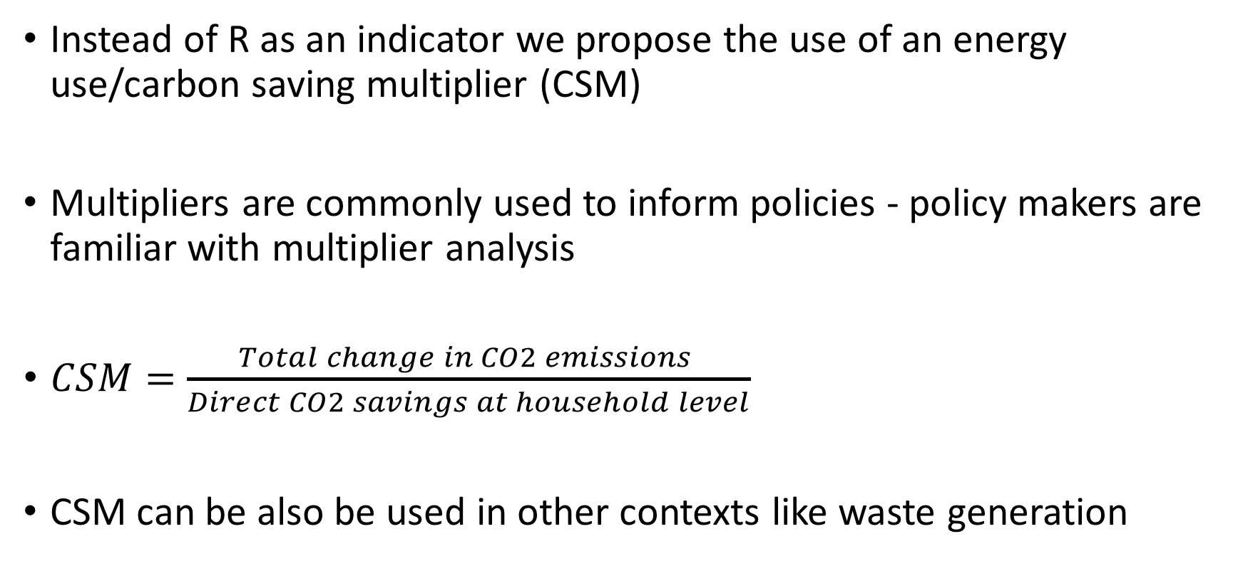
The saving multiplier
Instead of R as an indicator we propose the use of an energy use/carbon saving multiplier (CSM)
Multipliers are commonly used to inform policies - policy makers are familiar with multiplier analysis
$CSM=\frac{Total change in CO2 emissions }{Direct CO2 savings at household level}$
CSM can be also be used in other contexts like waste generation

Slide 11
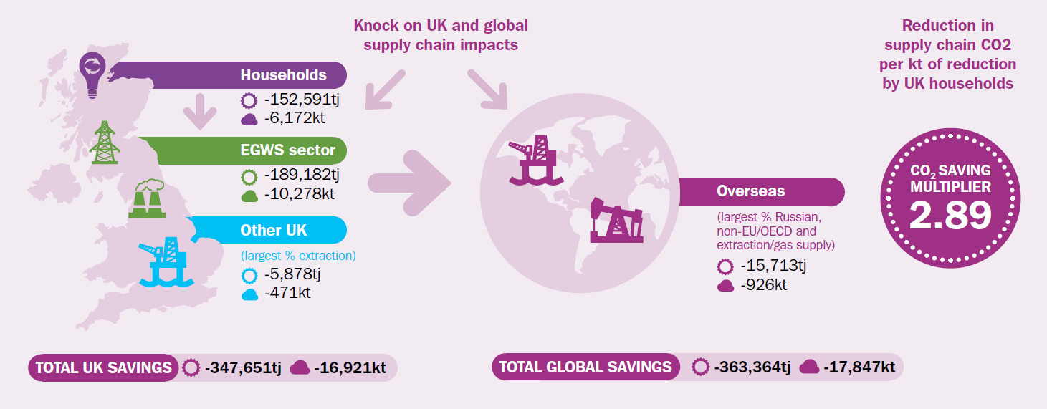

Slide 12
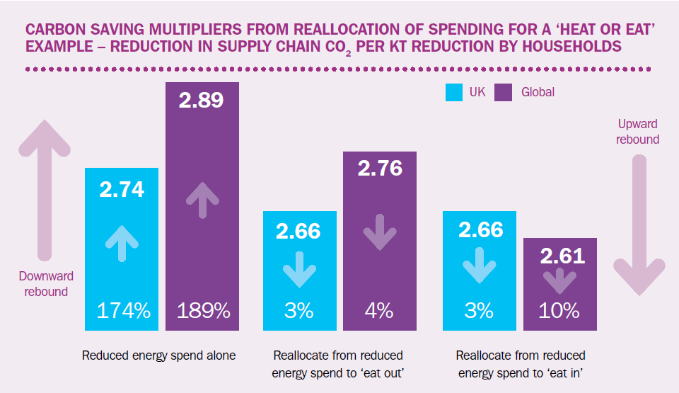
What is the meaning of CSM?
CSM reports the additional emissions savings achieved, per unit of emissions saved at the household level
Mostly positive but eroded by re-spending of savings
Policy focus to limit the erosion of the CSM

Slide 13
Thank you for your attention
For any questions and/or suggestions please feel free to contact us
karen.turner@strath.ac.uk
antonios.katris@strath.ac.uk
The paper from which the results were drawn is available at the conference online proceedings:
http://www.iaee.org/iaee2016/submissions/OnlineProceedings/IAEE%2039_2016TurnerKatris_on-line%20proceedings.pdf
Also available as a working paper at:
http://strathprints.strath.ac.uk/55426/
A policy briefing drawn from this paper can be found here:
http://cied.ac.uk/files/file.php?name=multiplier-analysis-of-re-spending-rebound-effects.pdf&site=440
EPSRC project website:
http://www.cied.ac.uk/research/impacts/energysavinginnovations

