Slide 1

CIED Summer SCHOOL 2017: achieving policy impact
The campaigning NGO perspective
Paul Steedman, Senior Campaigner
Friends of the Earth (England, Wales & Northern Ireland)
Notes:
Intro self

Slide 2
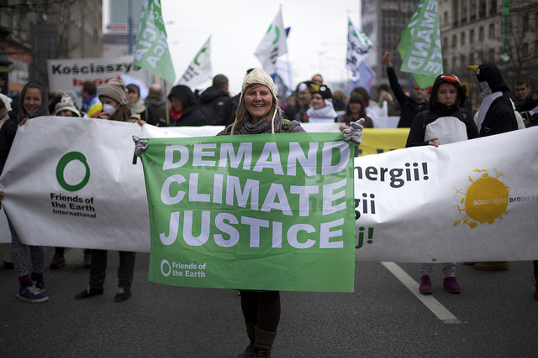
Notes:
FoE – the world’s largest grassroots environmental campaigning network
Federation of groups in over 70 countries, mainly in the global South
In EWNI – c. 150 local groups, thousands of activists, over 90% funded by donations from individuals
Environmental and social justice: sustainable development. EWNI’s goal: By 2030 the next generation will enjoy an environment that’s getting better: a safer climate, flourishing nature, and healthy air, water and food.
Main means of affecting systemic change in policy (or in corporate behaviour or social norms) = providing people with the expertise, skills, tools, strategy and structures to organise together to apply pressure on decision makers to act.
- media, petitioning, demonstrating solutions, publishing research, demonstrations, providing technical and legal expertise, acting in negotiations, etc
Achievements: doorstep recycling, national pollinator strategy, Climate Change Act
Fundamentally political, though not partisan.
We do get into technical detail, but most often about steering the direction of travel.

Slide 3
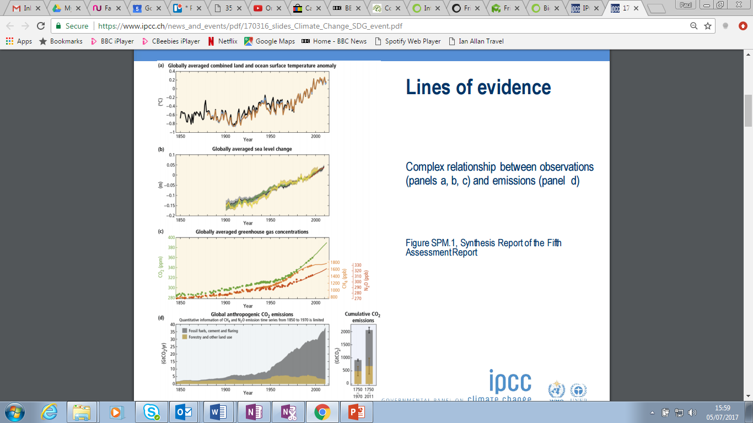
Notes:
We use (academic) research to:
Inform our overall analysis of the problems that need addressing, their scale, causes, etc (e.g. climate science)
Potential solutions (technologies, behaviours, business models)
Barriers and opportunities in how the world is changing (e.g. economic models and assumptions, SPRU ‘grassroots innovation’ thinking)
Understanding how change happens (e.g. history project)
That will help inform our overall strategic goals, the particular campaigns we run and the solutions we advocate.
But: always in a political context.

Slide 4
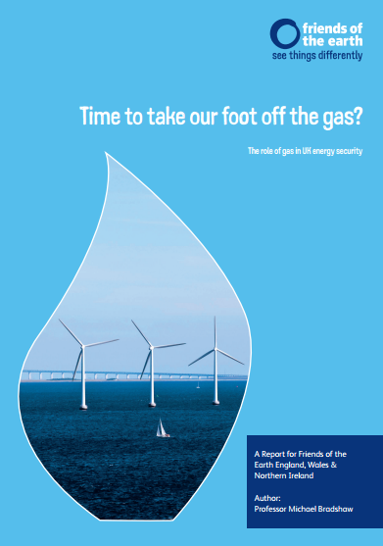
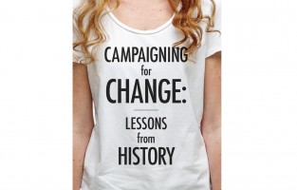
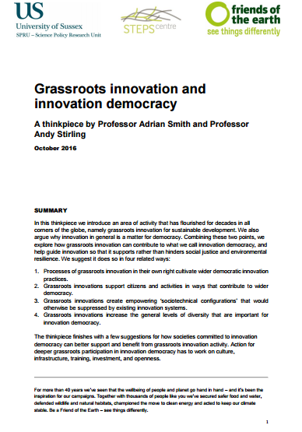
Notes:
BUT:
- we rarely read academic journals
we often come across studies via mainstream or specialist press, mailing lists and social media, and usually through write-ups or secondhand accounts of them, not via the original stuff
There’s a whole world of ‘policy thinking’ – thinktanks, politicians, NGOs, unions, trade associations
- we do mix at conferences, but we're often most interested in what other policy/govt/business people have to say at them
- we value the credibility that comes with academia, which is why we like to commission academics to write papers for us (but we often want them to say the things that we already want to say!)
- we frequently think that some academics are miles off the cutting edge, only telling us what is already widely accepted within the policy world - or, worse, pushing theoretically-pure but politically-naive (and consequently sometimes damaging) lines

Slide 5
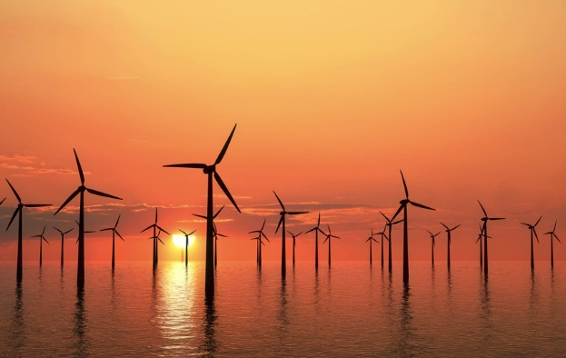
Notes:
Conclusions:
If you’d like your work to influence what happens in the world, not only to describe and analyse it, then engaging with actors outside academia is essential
That doesn’t necessarily just mean engaging with civil servants, politicians or business leaders – civil society plays an important role
Influencing NGOs, thinktanks, ‘the policy community’ etc is an active process – you have to go to where they are, by and large
Expect a political environment and challenge about deliverability
Without question the worst thing you can do is to design your research project without talking to stakeholders first, and then publish a policy briefing on a university website without an adequate dissemination strategy
Your research has to be relevant
Your research has to give some hints about what decision makers should do
You need to consider how it will influence. A publication may not be as useful as a workshop or roundtable.
You know more than your audience; don’t afraid to share your thinking, just be clear what is evidenced and what is conjecture.

Slide 6
Paul Steedman, Senior Campaigner
Friends of the Earth (England, Wales & Northern Ireland)
paul.Steedman@foe.co.uk
@paulsteedman1

