Slide 1
Achieving policy impact
Fraser Macleod
Social Research
Department for Business, Energy and Industrial Strategy
11. 07. 2017

Slide 2
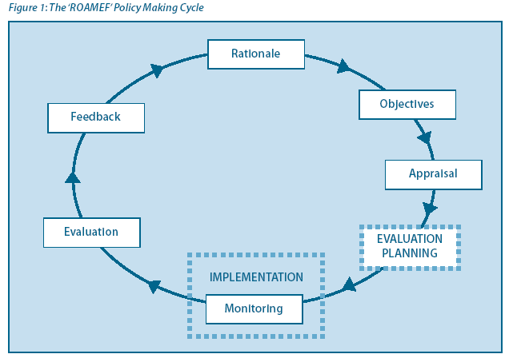
Role of Government Social Researchers
SOCIAL RESEARCH

Slide 3
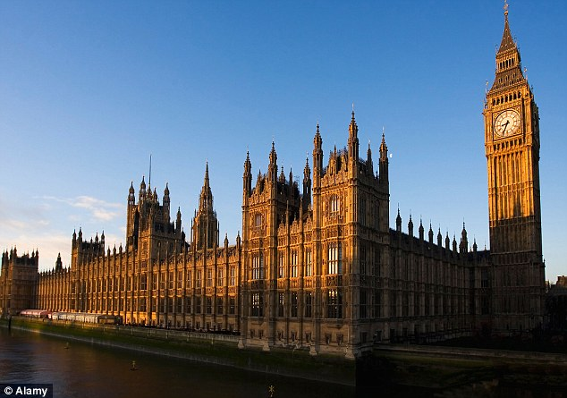
Are Civil Servants isolated in an Ivory Tower?

Slide 4

Forms of academic engagement
Type of engagement | Examples
Civil Servants join academic steering groups. | BEIS Head of Social Research on CIED Advisory Group. British Academy/ Lancaster Uni review of international approaches to community led renewable energy.
Joint Seminars | Seminars within DECC/ BEIS e.g. CIED research on rebound effects. ‘Show and tell’ days – e.g. DECC researchers visit Oxford ECI.
Funding collaboration on a joint project | Centre for Energy Epidemiology (UCL) project to design socio-technical longitudinal survey on household energy use.
Academic advise on methodological issues | CECAN advise on evaluation methods for complex programmes (CfD).
Interns/ Secondments | UCL PhD student review of impact of different heating controls.

Slide 5

Achieving impact on policy process
Impact = Quality + Relevance x Communication
1. Clarity | Use plain English in research summaries.
2. Relevance | Keep up to date on policy debates. Consider policy implications – give suggestions.
3. Use existing Comms | e.g. e-newsletters, Uni reps who engage with Gov.
4. Networking | Identify relevant people in Gov Depts. Offer seminars/ invite to yours.
5. Secondments | Consider offering time to work in Gov Dept.
6. Support for projects | Request letter of support in funding. Ask policy rep to join steering group.

